Slide 1

Go, change the world
RV College of
Engineering
WiDeep: WiFi-based Accurate and Robust Indoor Localization System using Deep Learning

Slide 2

Abstract
Go, change the world
RV College of
Engineering
Indoor localization refers to determining the exact location of an object or person within a building using available signals, in this case, WiFi.
The goal of WiDeep is to achieve precise and reliable “indoor localization” despite the challenges posed by noise and environmental changes in WiFi signals.

Slide 3
Challenges
Go, change the world
RV College of
Engineering
Traditional WiFi-based systems suffer from degraded accuracy due to noise and unstable wireless signals.
Changes in the environment can further complicate these systems' ability to accurately determine location.
Propagation-Based Techniques: Models the relationship between the received signal strength and distance without needing prior site surveys or calibration.
Advantages: Easier to deploy since they don’t require detailed site surveys.
Disadvantages: Less accurate, with heterogeneous devices (different phones).

Slide 4
Solutions
Go, change the world
RV College of
Engineering
Fingerprinting-Based Techniques:
Uses recorded WiFi access point (AP) signatures (fingerprints) to estimate location.
Process:
Offline Phase (Calibration): Record signal strength readings from APs at known locations to create a map of fingerprints.
Tracking Phase: Compare current signal measurements to the stored fingerprints to estimate the location, either deterministically (fixed rules) or probabilistically (using statistical methods).
Advantages: Provides better accuracy compared to propagation-based techniques
Challenges: Noise in wireless signals can impact accuracy. Various systems have been developed to address these challenges. Deep Learning is one approach

Slide 5
Approach
Go, change the world
RV College of
Engineering
DEEP LEARNING MODEL:
WiDeep utilizes a deep learning technique known as stacked denoising autoencoders.
These autoencoders are used to clean and process the noisy WiFi signals.
Denoising autoencoders are neural networks designed to remove noise from input data, which helps in improving the quality of the signal data used for localization.

Slide 6
Approach
Go, change the world
RV College of
Engineering
PROBABILISTIC FRAMEWORK:
Along with the deep learning model, WiDeep incorporates a probabilistic framework to model and handle uncertainties in the received WiFi signals.
This helps in understanding and predicting the relationship between the WiFi access points (APs) and the device's location more accurately.
They handle noise better than deterministic methods but may assume signal independence between APs, which can limit accuracy.

Slide 7
Approach
Go, change the world
RV College of
Engineering
HYBRID TECHNIQUES:
Use additional sensors or data to improve accuracy. However, these techniques might not be supported by all mobile devices.
DETAILED CHANNEL STATE INFORMATION:
Specialized WiFi chips can provide more detailed data to combat noise, but this is not widely supported across all mobile devices.

Slide 8
WiDEEP
Go, change the world
RV College of
Engineering
WiDeep leverages deep learning to capture
between WiFi access points (APs) and their corresponding fingerprint locations.
Accounts for CORRELATION between different APs:
Unlike traditional probabilistic techniques that assume APs' signals are independent, WiDeep's deep learning model accounts for the correlation between different APs.
complex, non-linear relationships

Slide 9
WiDEEP
Go, change the world
RV College of
Engineering
Handling Device Heterogeneity:
WiDeep uses stacked denoising autoencoders, a type of deep learning model that robustly processes noisy data. These autoencoders help in extracting meaningful representations of the relationship between noisy WiFi scans and fingerprint locations.
Regularization Technique:
To enhance robustness and prevent overfitting, WiDeep incorporates a regularization technique that improves the system’s generalization capability.

Slide 10
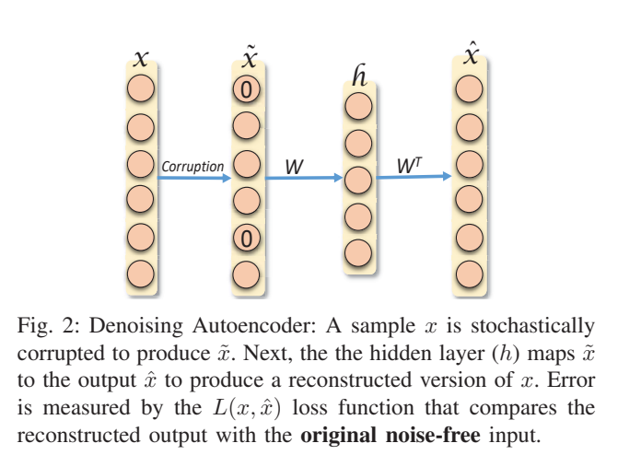
Denoising Autoencoder
Go, change the world
RV College of
Engineering

Slide 11
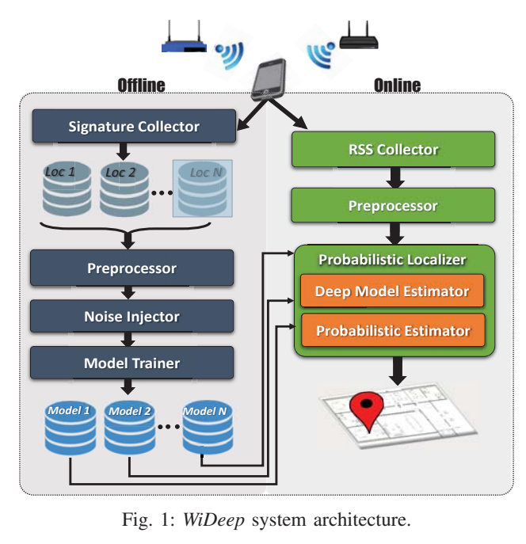
WiDEEP Architecture
Go, change the world
RV College of
Engineering

Slide 12
WiDEEP Architecture
Go, change the world
RV College of
Engineering
WiDeep Offline Training Phase: Involves collecting data, preprocessing it, injecting noise, training deep neural networks for each reference point, and storing these models.
Online Localization Phase: Involves real-time data scanning, preprocessing, and using the trained models to estimate the user's location through probabilistic methods.

Slide 13
Evaluation
Go, change the world
RV College of
Engineering
Testbeds:
WiDeep was implemented on various Android phones in two different environments:
A 629 square meter university building.
A 65 square meter residential apartment.
Varied Conditions: These testbeds had different layouts and densities of WiFi access points, providing a comprehensive evaluation of WiDeep’s performance.

Slide 14
Performance
Go, change the world
RV College of
Engineering
Accuracy: WiDeep achieved a mean localization accuracy of:
2.64 meters in the university building.
1.21 meters in the residential apartment.
Comparison: WiDeep outperformed traditional fingerprinting techniques and other basic deep learning methods by at least 29.8% and up to 168% in mean accuracy.
Robustness: The system maintained high accuracy even with a decrease in access point density and across different devices, demonstrating its robustness and effectiveness in various scenarios.

Slide 15
Thank You
Go, change the world
RV College of
Engineering

